Slide 1
Unit 2 For Live Session Assignment: Inference Using t-Distributions
Distribution of the sample average
Using t-distribution for one sample inference
Starting to explore t-distribution for two sample problems
Measuring uncertainty in randomized and observational studies

Slide 2
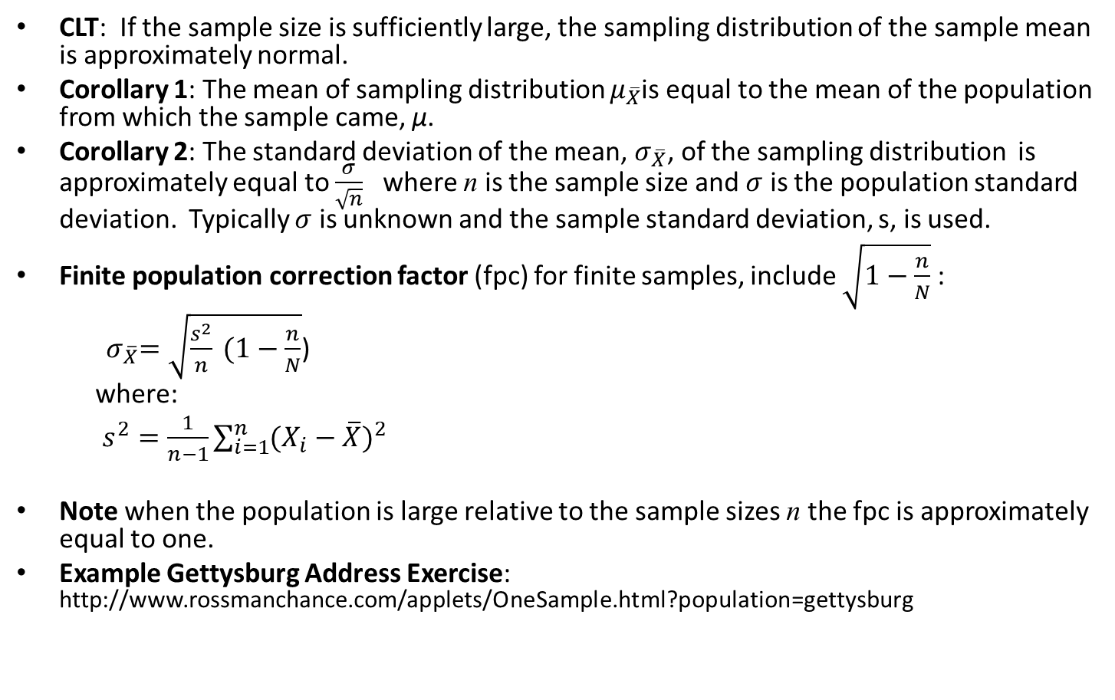
Central Limit Theorem and Sampling Distribution
CLT: If the sample size is sufficiently large, the sampling distribution of the sample mean is approximately normal.
Corollary 1: The mean of sampling distribution $μ_{\overline{X}}$is equal to the mean of the population from which the sample came, μ.
Corollary 2: The standard deviation of the mean, $σ_{\overline{X}}$, of the sampling distribution is approximately equal to $\frac{σ}{\sqrt{n}}$ where n is the sample size and $σ$ is the population standard deviation. Typically $σ$ is unknown and the sample standard deviation, s, is used.
Finite population correction factor (fpc) for finite samples, include $\sqrt{1−\frac{n}{N}}$ :
${ σ}_{\overline{X}}=\sqrt{\frac{s^{2}}{n} (1−\frac{n}{N}}$)
where:
$s^{2}=\frac{1}{n−1}\sum_{i=1}^{n}{{(X_{i}−\overline{X})}^{2}}$
Note when the population is large relative to the sample sizes n the fpc is approximately equal to one.
Example Gettysburg Address Exercise: http://www.rossmanchance.com/applets/OneSample.html?population=gettysburg

Slide 3
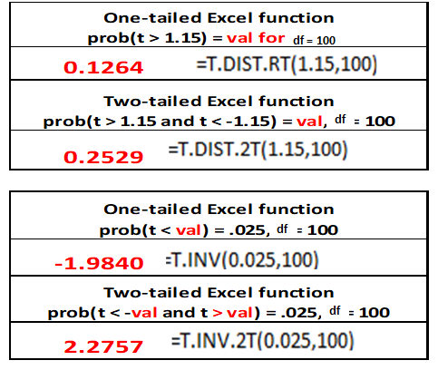
Some Useful Excel Functions

Slide 4
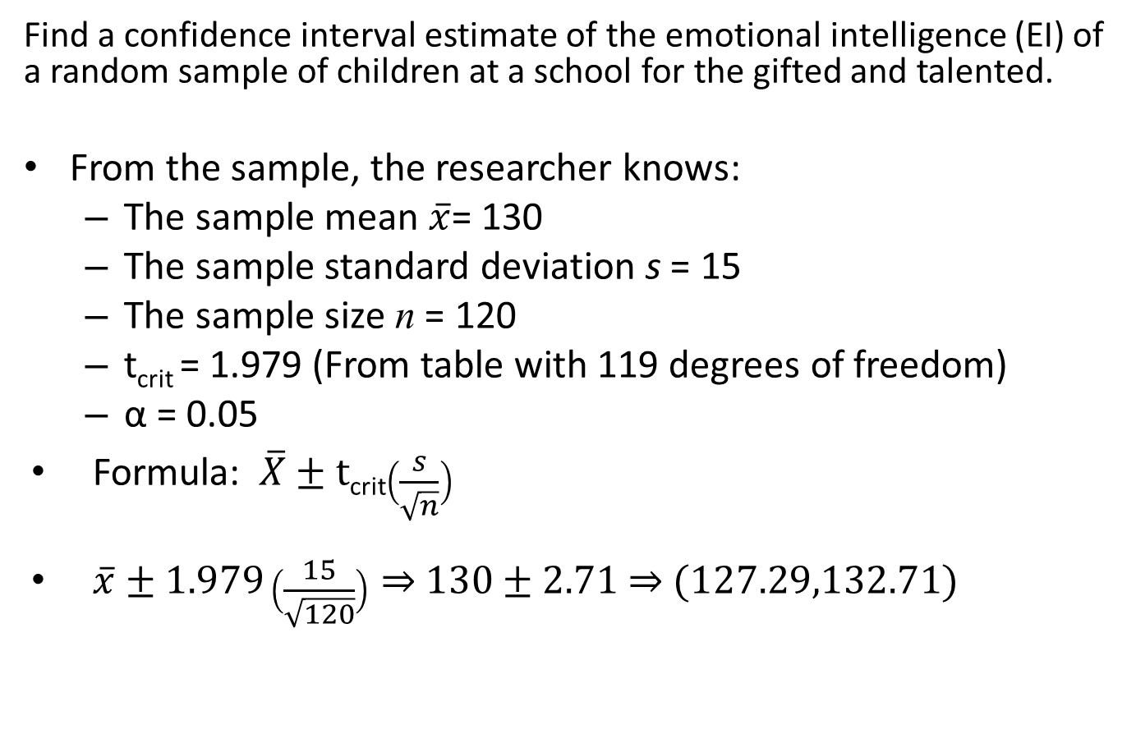
One Sample Confidence Interval (Section 2.5 Asynchronous Videos)
Find a confidence interval estimate of the emotional intelligence (EI) of a random sample of children at a school for the gifted and talented.
From the sample, the researcher knows:
The sample mean $\overline{x}$= 130
The sample standard deviation s = 15
The sample size n = 120
t_{crit} = 1.979 (From table with 119 degrees of freedom)
α = 0.05
Formula: $\overline{X}±t$_{crit}$\left(\frac{s}{\sqrt{n}}\right)$
$\overline{x}±1.979\left(\frac{15}{\sqrt{120}}\right)⇒$ $130±$ 2.71 $⇒$ $(127.29,132.71)$

Slide 5
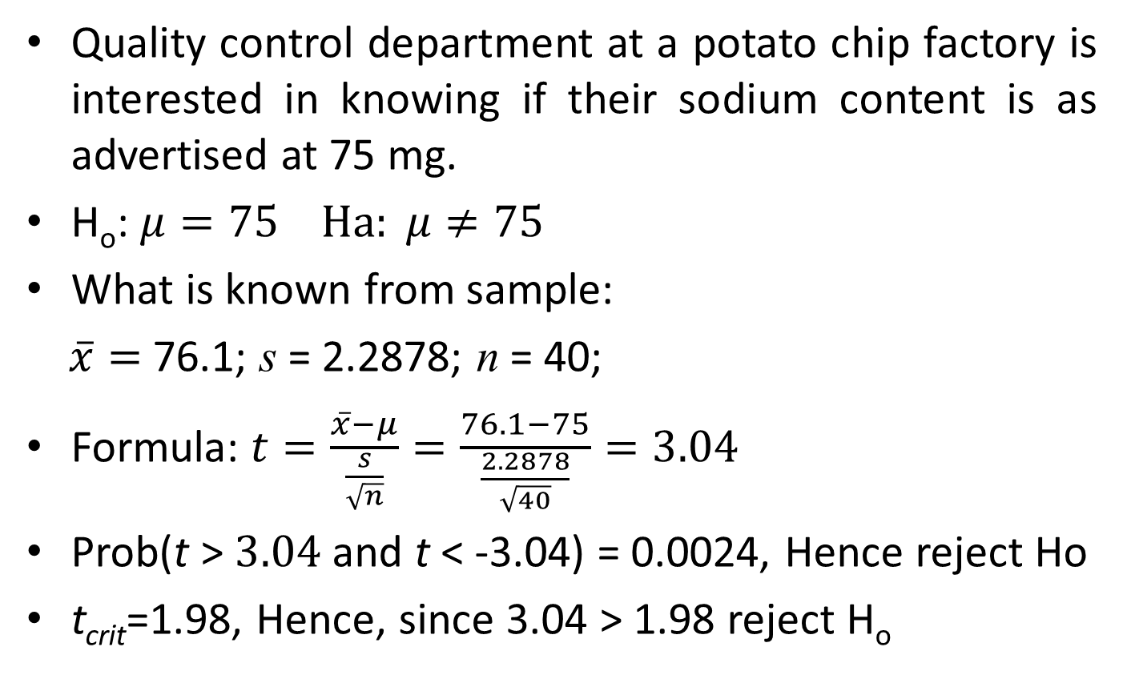
One Sample Hypothesis Test (Two Sided) (Section 2.6 Asynchronous Videos)
Quality control department at a potato chip factory is interested in knowing if their sodium content is as advertised at 75 mg.
H_{o}: $μ=75 Ha: μ≠75$
What is known from sample:
$\overline{x}=$76.1; s = 2.2878; n = 40;
Formula: $t=\frac{\overline{x}−μ}{\frac{s}{\sqrt{n}}}=\frac{76.1−75}{\frac{2.2878}{\sqrt{40}}}=3.04$
Prob(t > $3.04$ and t < -3.04) = 0.0024, Hence reject Ho
t_{crit}=1.98, Hence, since 3.04 > 1.98 reject H_{o}
Slightly different from McGee

Slide 6
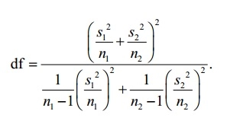
Satterthwaite Formula for Degrees of Freedom
For Our Two-Sample Confidence Interval and T-test we use the approach of assuming unequal variances in the population and use the Satterthwaite formula for degrees of freedom to evaluate our t statistics.
The degrees of freedom formula is given by:
The formula is a complex calculation. SAS and R have options to calculate t values assuming unequal variances.

Slide 7

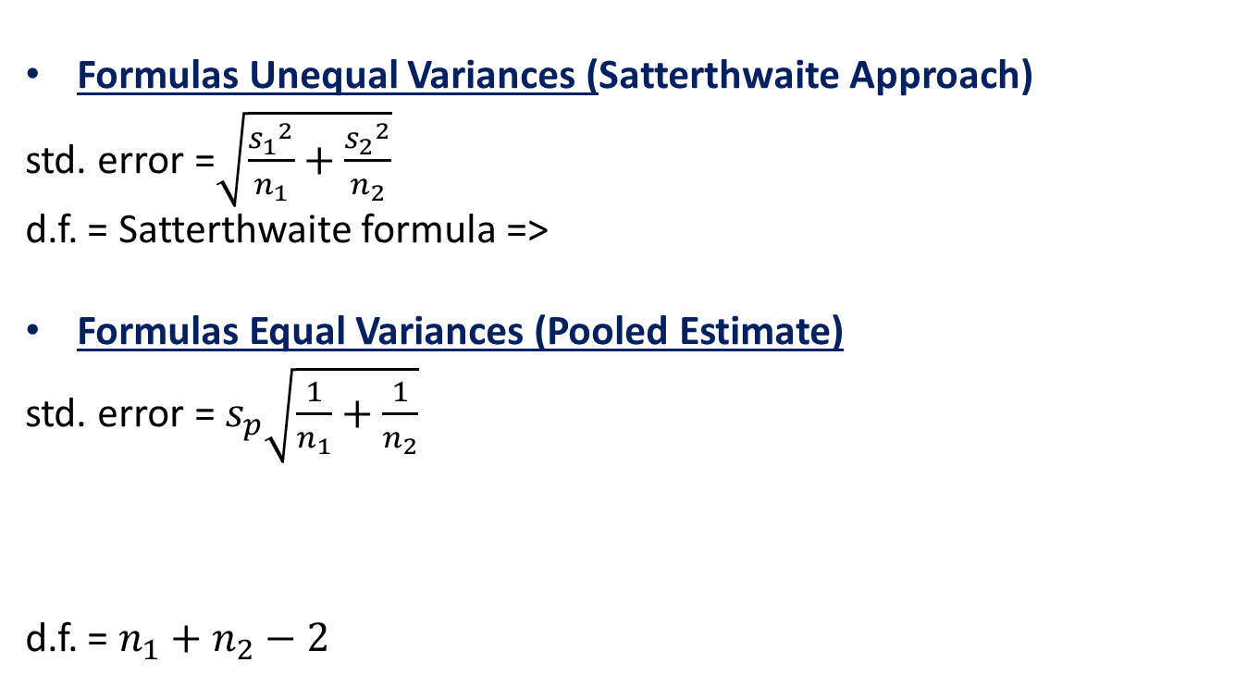
Two Sample Confidence Interval and Hypothesis Testing for Mean Differences Assumptions About Population Variances
Formulas Unequal Variances (Satterthwaite Approach)
std. error =$\sqrt{\frac{{s_{1}}^{2}}{n_{1}}+\frac{{s_{2}}^{2}}{n_{2}}}$
d.f. = Satterthwaite formula =>
Formulas Equal Variances (Pooled Estimate)
std. error =${ s}_{p}\sqrt{\frac{1}{n_{1}}+\frac{1}{n_{2}}}$
d.f. = $n_{1}+n_{2}−2$
SAS prints out
SAS prints out

Slide 8
Two Sample Confidence Interval (Section 2.9 Asynchronous Videos)
Students are assigned to one of two groups. One group views a statistics video disk and the other views the disk and does a lab. They are then given a statistics test. Calculate a confidence interval using α = 0.05 for the difference between the mean test scores of the two groups.

Slide 9
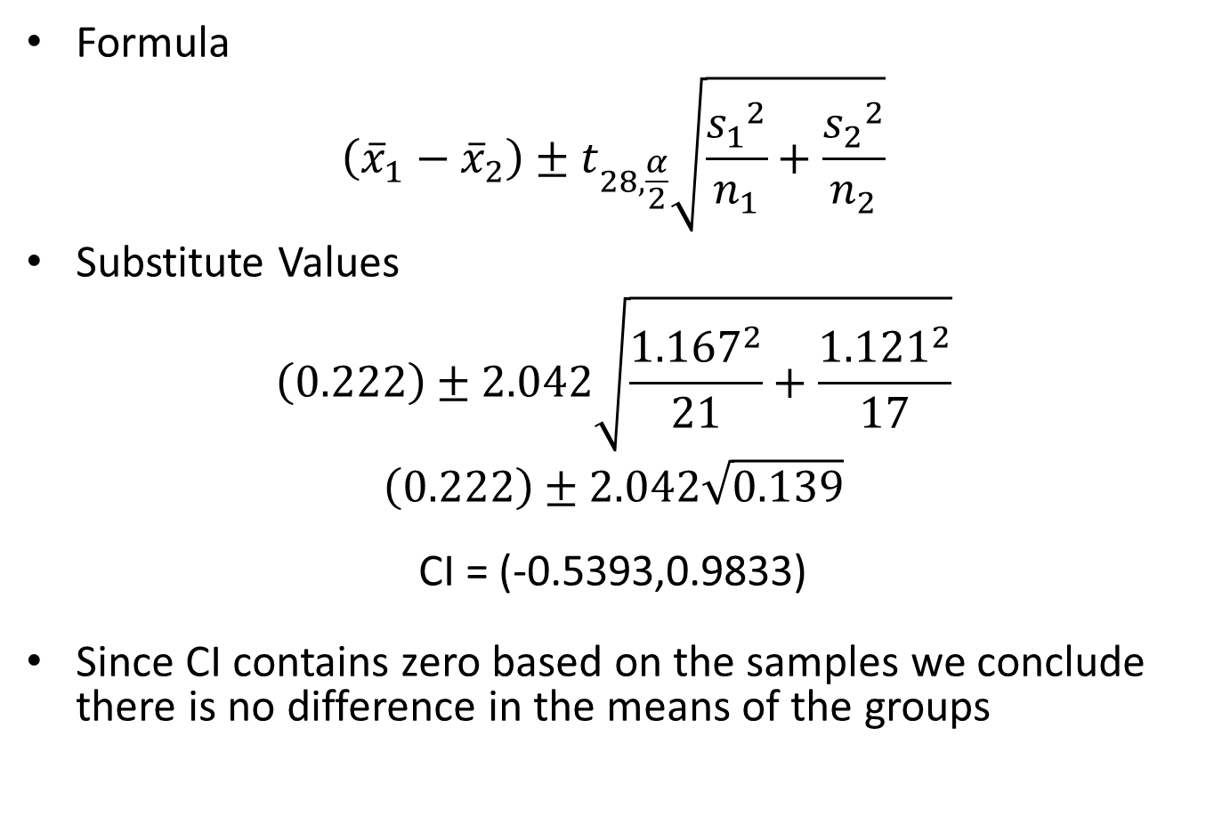
Two Sample Confidence Interval - Continued
Formula
$$\left({\overline{x}}_{1}−{\overline{x}}_{2}\right)±t_{28,\frac{α}{2}}\sqrt{\frac{{s_{1}}^{2}}{n_{1}}+\frac{{s_{2}}^{2}}{n_{2}}}$$
Substitute Values
$$\left(0.222\right)±2.042\sqrt{\frac{{1.167}^{2}}{21}+\frac{{1.121}^{2}}{17}}$$
$$\left(0.222\right)±2.042\sqrt{0.139}$$
CI = (-0.5393,0.9833)
Since CI contains zero based on the samples we conclude there is no difference in the means of the groups
T degree freedom needs to be 36
T crit = 2.028
Different from McGee

Slide 10
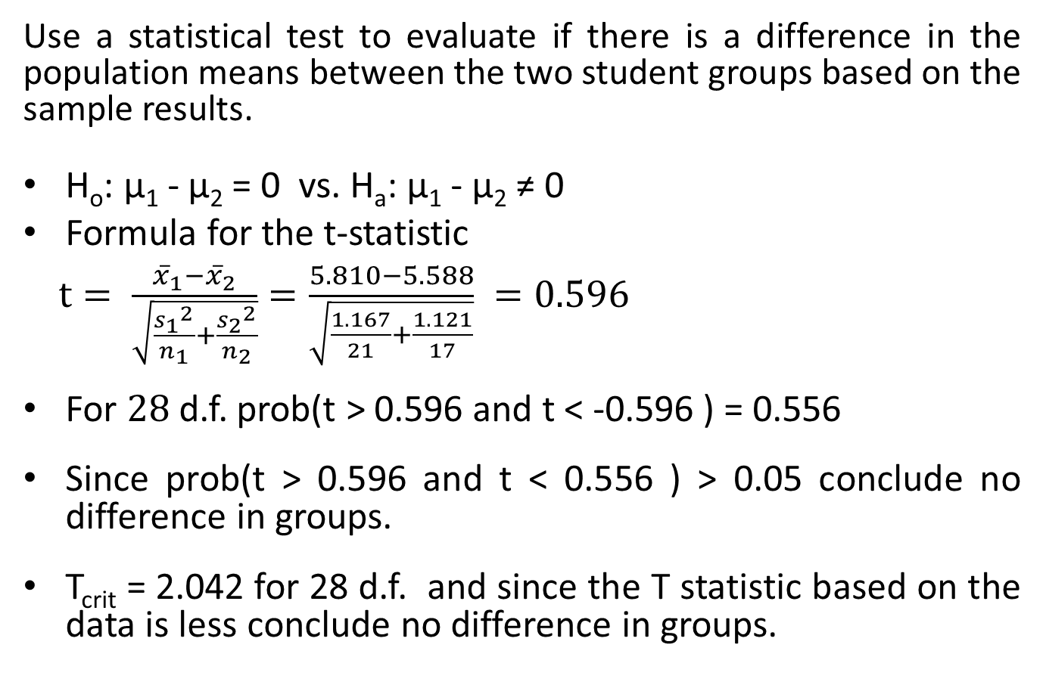
Two Sample Hypothesis Test (Section 2.9 Asynchronous Videos)
Use a statistical test to evaluate if there is a difference in the population means between the two student groups based on the sample results.
H_{o}: µ₁ - µ₂ = 0 vs. H_{a}: µ₁ - µ₂ ≠ 0
Formula for the t-statistic
$t= \frac{{\overline{x}}_{1}−{\overline{x}}_{2}}{\sqrt{\frac{{s_{1}}^{2}}{n_{1}}+\frac{{s_{2}}^{2}}{n_{2}}}}=\frac{5.810−5.588}{\sqrt{\frac{1.167}{21}+\frac{1.121}{17}}} =0.596$
For $28$d.f. prob(t > 0.596 and t < -0.596 ) = 0.556
Since prob(t > 0.596 and t < 0.556 ) > 0.05 conclude no difference in groups.
T_{crit} = 2.042 for 28 d.f. and since the T statistic based on the data is less conclude no difference in groups.

Slide 11
For Session 2 Homework SAS Code: Session 2.sas
proc power with one sample means
proc power with two sample means

Slide 12
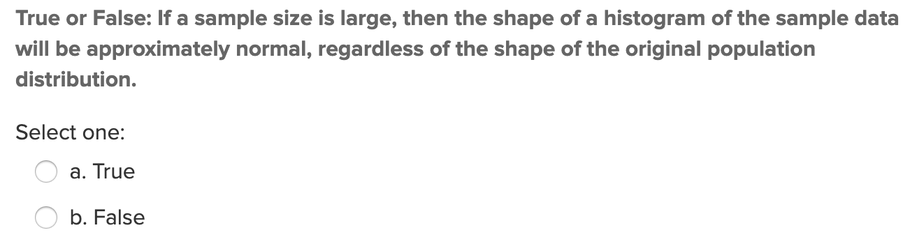
Quick Quiz Question (QQQ 1)

Slide 13
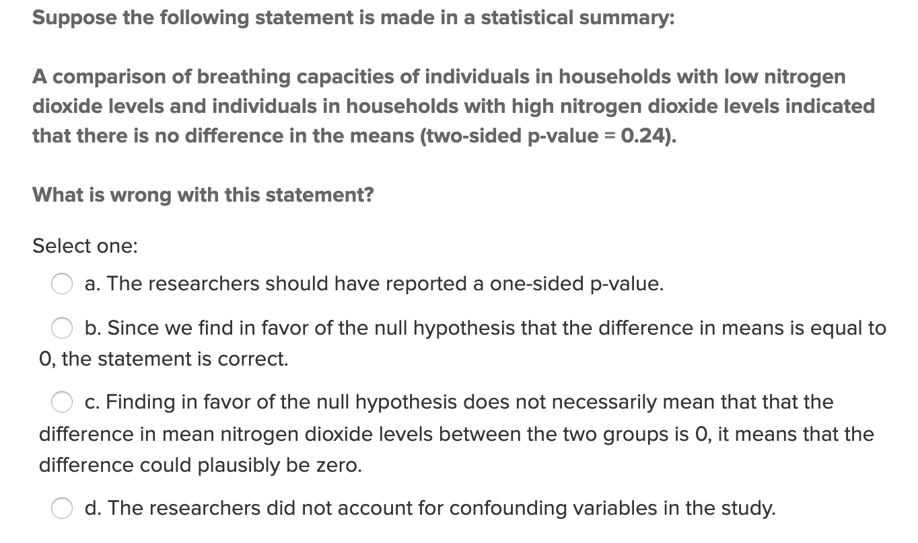
QQQ 2

Slide 14
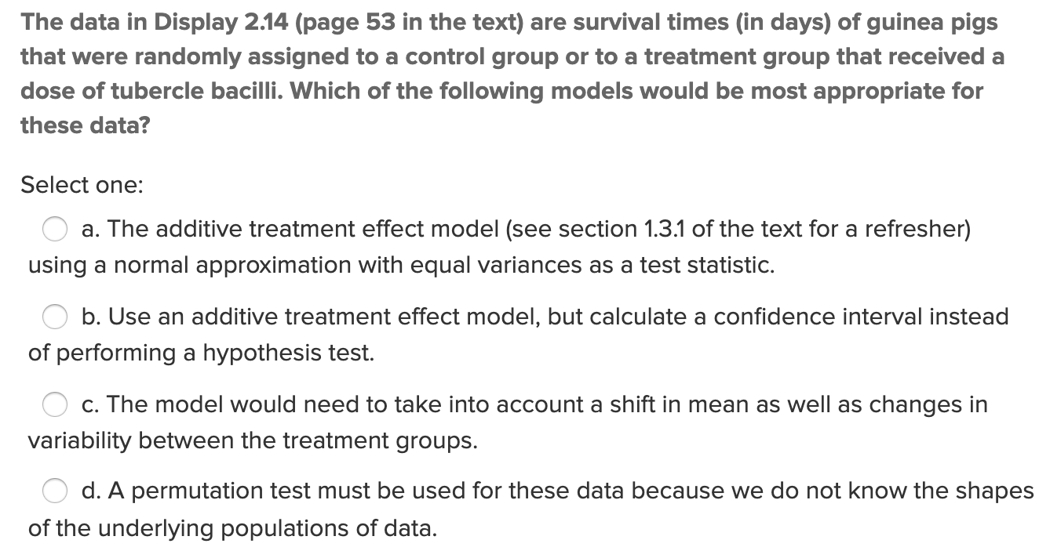
QQQ 3

Slide 15
1 Sample Hypothesis Testing: The 6 Steps
Identify H₀ and H_{a}.
Find the Critical Value(s) and Draw and Shade.
Calculate the Test – Statistic. (The evidence.)
Calculate the p-value.
Make a decision… Reject H₀ or or not enough evidence to reject H₀.
Write a clear conclusion in the context of the problem. Use mostly non-statistical terms but always report the p-value. Add a confidence interval if appropriate. End this conclusion with a statement about the scope.

Slide 16

Question 1 ($≤2$ hours)

Slide 17
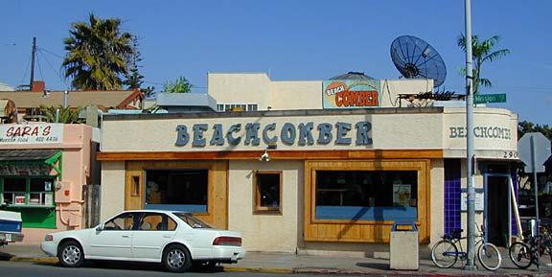
Question 1: One Sample Confidence Interval
The following are ages of 7 randomly selected patrons at the Beach Comber in South Mission Beach at 7pm. We assume that the data come from a normal distribution and would like to construct and interpret a 95% confidence interval for the actual mean age of patrons at the Comber. Assume we don’t know the population standard deviation and have estimated it to be 7.08 years. In addition, the t multiplier (t critical value) for this problem is 2.447. The other statistics needed to construct the interval will need to be derived from the data. Manually construct a CI and explain your work.
25, 19, 37, 29, 40, 28, 31

Slide 18

Question 2 ($≤$1 hour)

Slide 19
Question 2: One Sample t-test
The following are ages of 7 randomly chosen patrons seen leaving the Beach Comber in South Mission Beach at 7pm! We assume that the data come from a normal distribution and would like to test the claim that the mean age of the distribution of Comber patrons is different than 21. Conduct a 6 step one sample 2-sided t-test with alpha = .05 to test this claim. Provide enough explanation to fully describe each step. Recall that Step 2 is finding the critical value which is the same as the t multiplier in the corresponding 95% confidence interval. Do the calculations manually and confirm them in SAS or R.
25, 19, 37, 29, 40, 28, 31

Slide 20

Question 3 ($≤2$ hours)

Slide 21
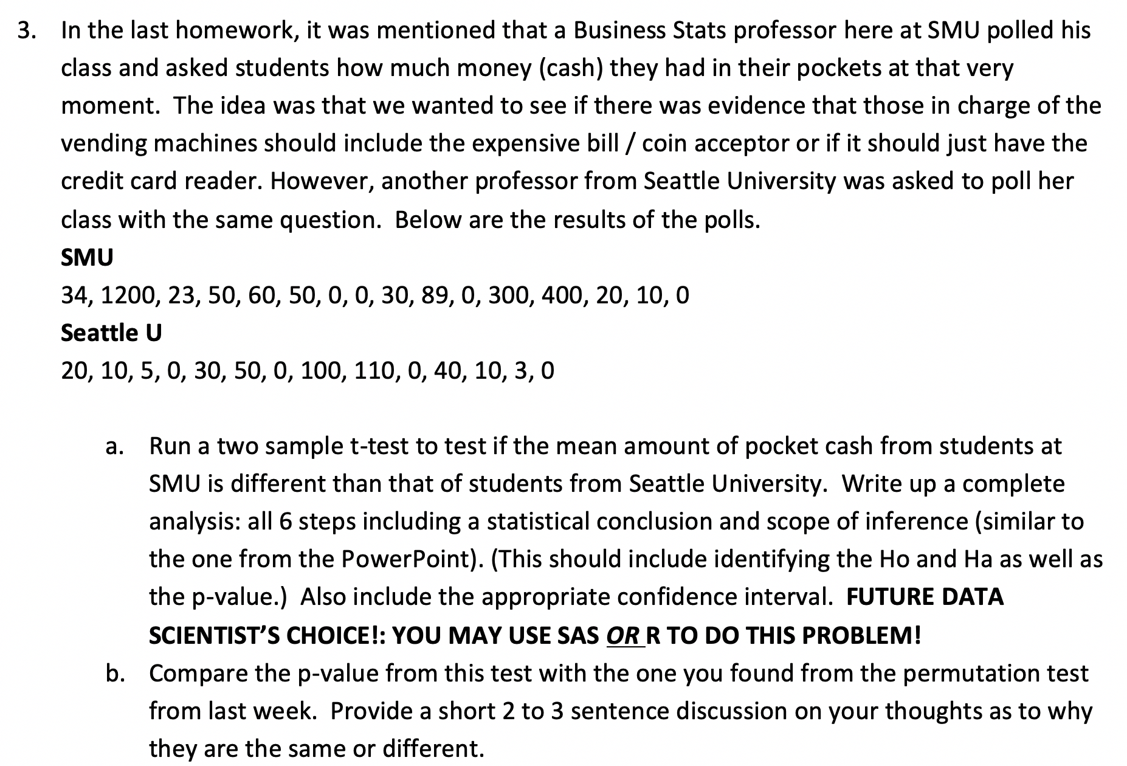
Q 3: Also in the Homework

Slide 22
Question 4! Takeaways and Questions!
Please provide at least 4 takeaways from this unit and any question you had in this unit.
These will be used to design live session!

